Slide 1
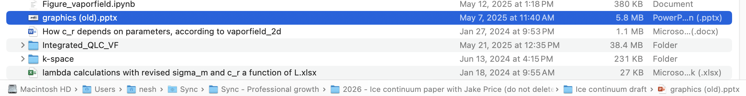
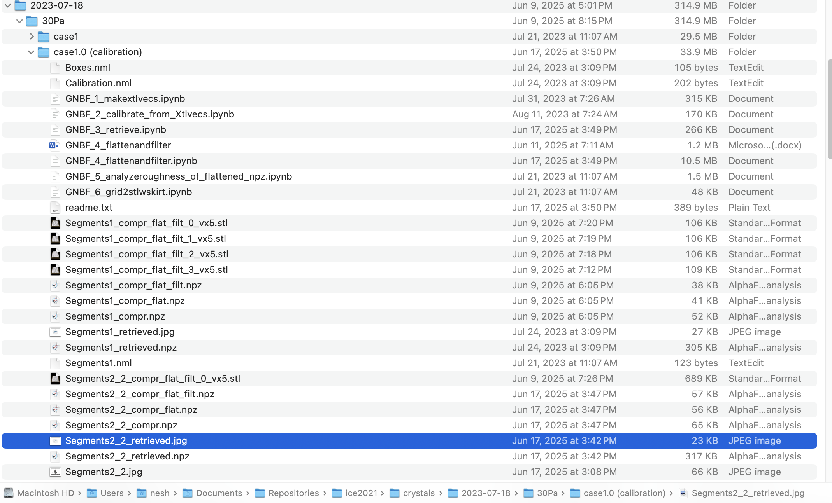
The following ppt slide was taken from:
The data for that slide is here:

Slide 2
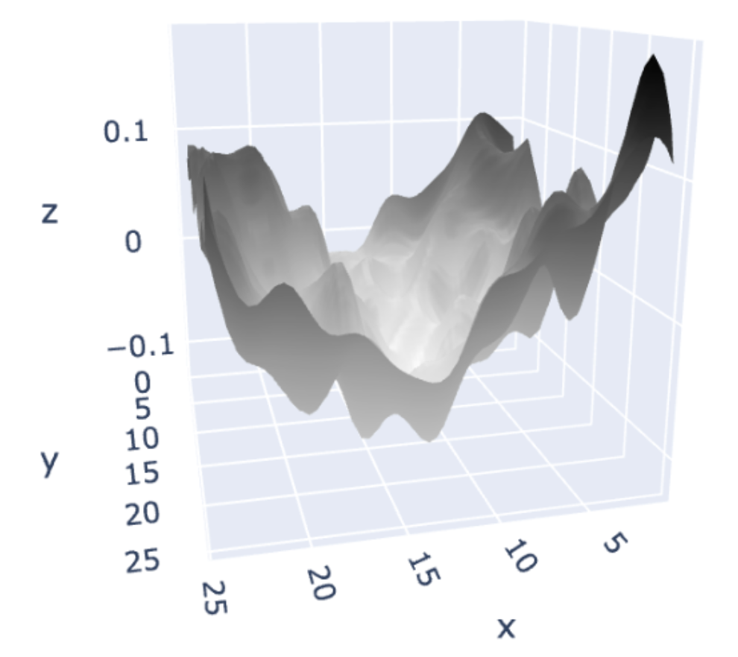
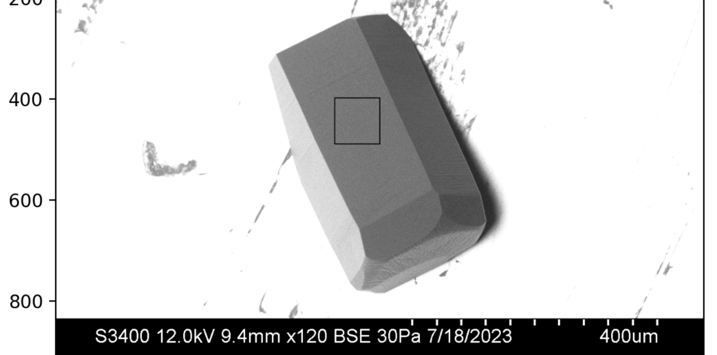

c
$$∆h$$
a
L

Slide 3
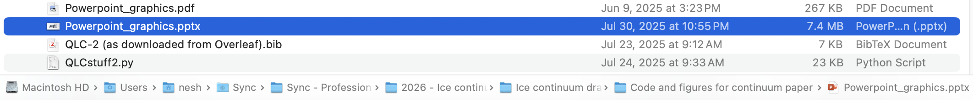
The next two ppt slides were taken from here:

Slide 4
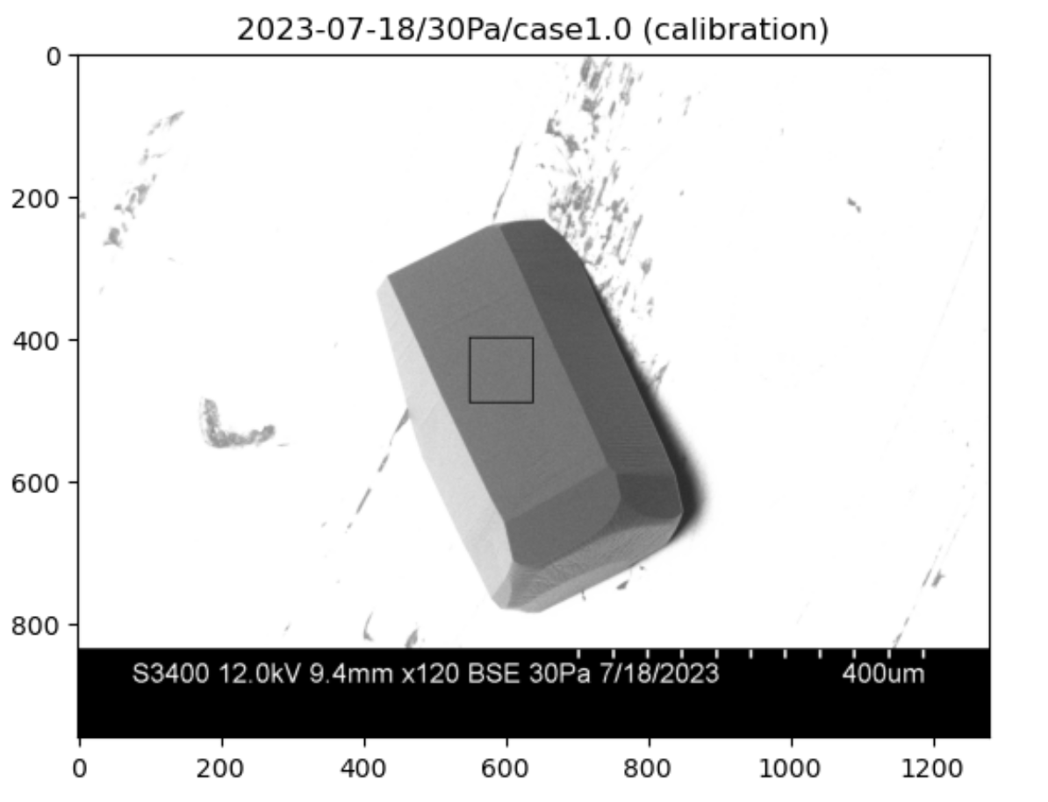
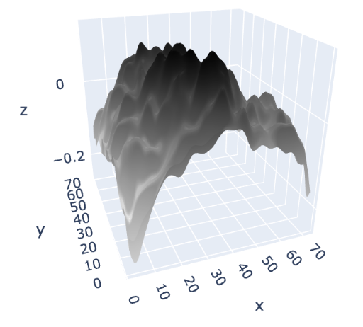
y
x
c
a

Slide 5
GNBF/SEM
retrieval region
y
x
c
a

Slide 6
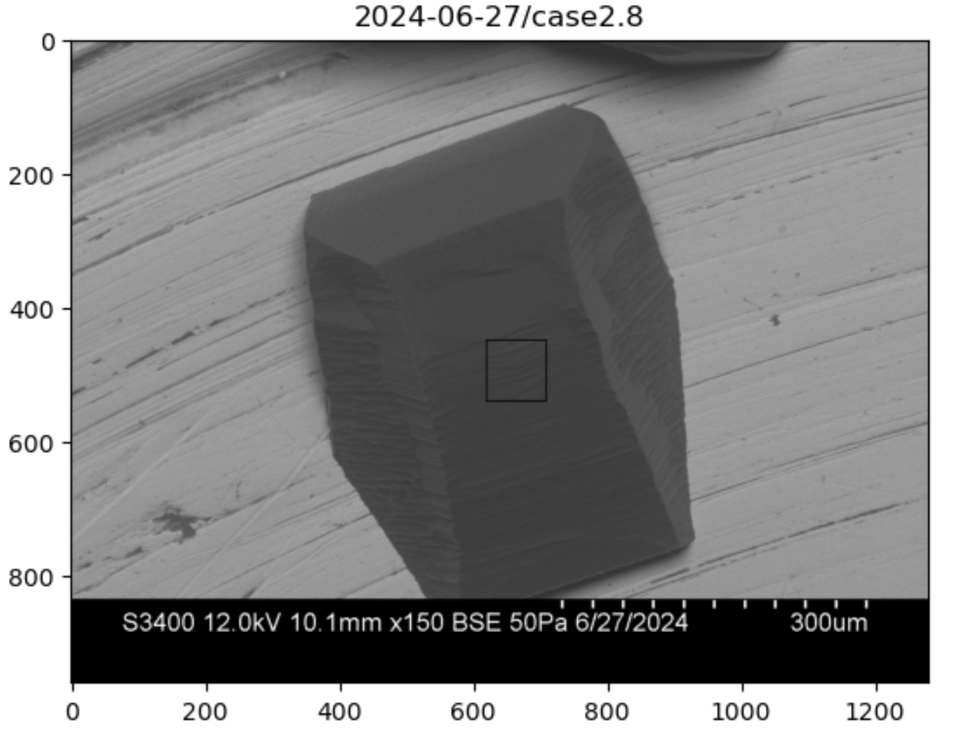
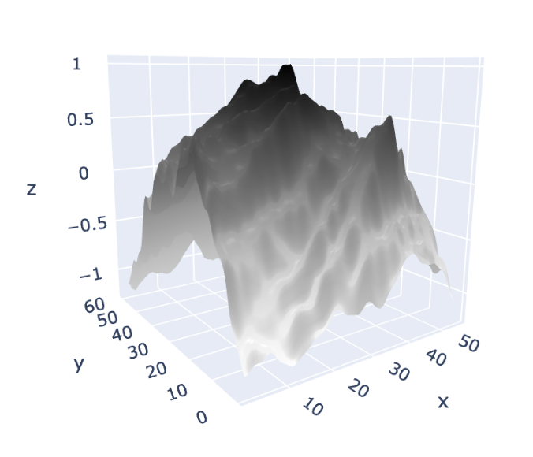
GNBF/SEM
retrieval region
y
x

Slide 7
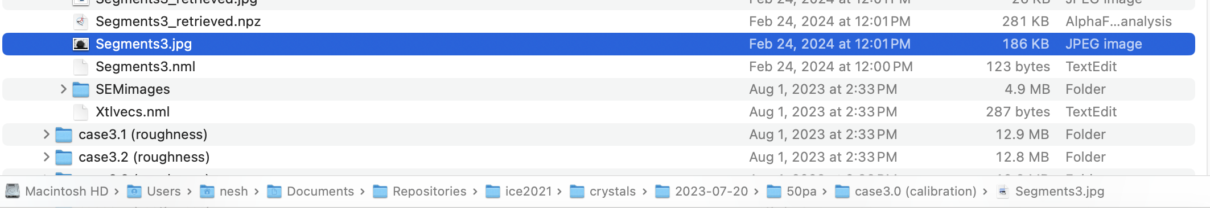
The data for the next slides are located here:

Slide 8
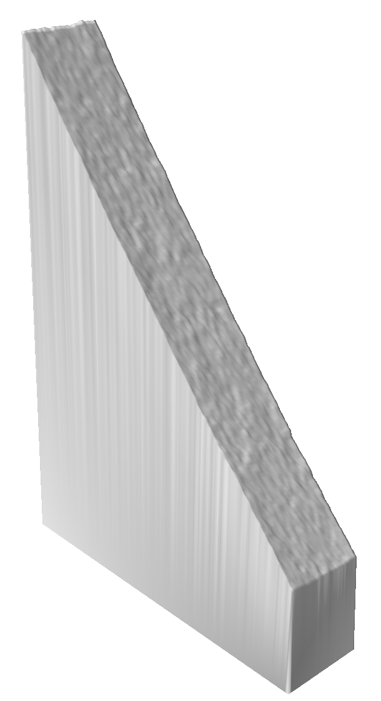
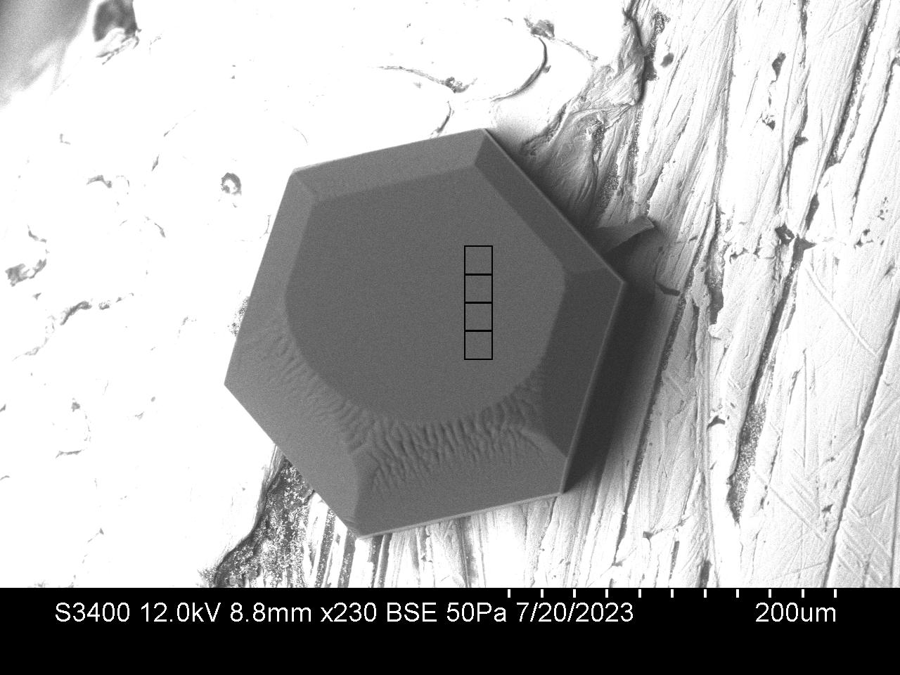
This is what we have for Segments1 – the horizontal aspect ratio is 1:1, but the vertical has been amplified by x10

Slide 9
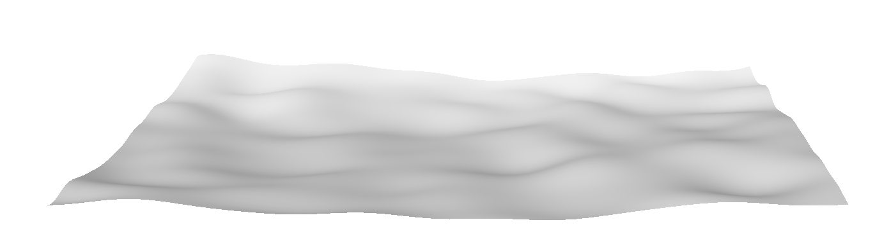
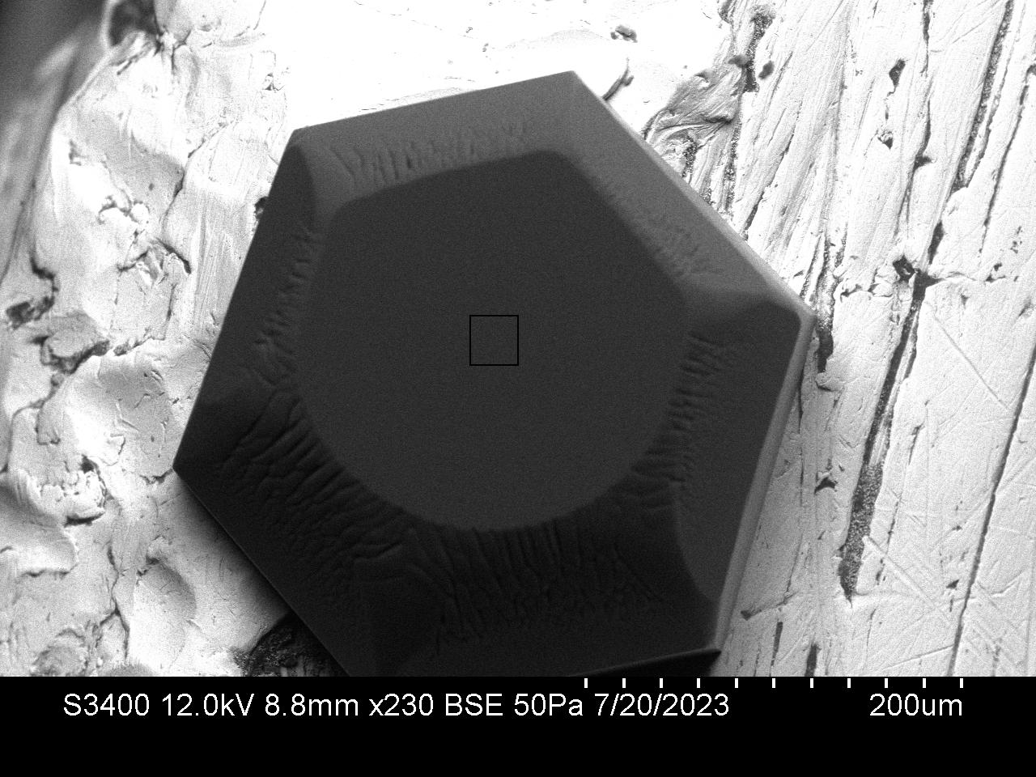
This is what we have for Segments3 – the horizontal aspect ratio is correct, but I haven’t tracked down what the vertical aspect ratio is

Slide 10
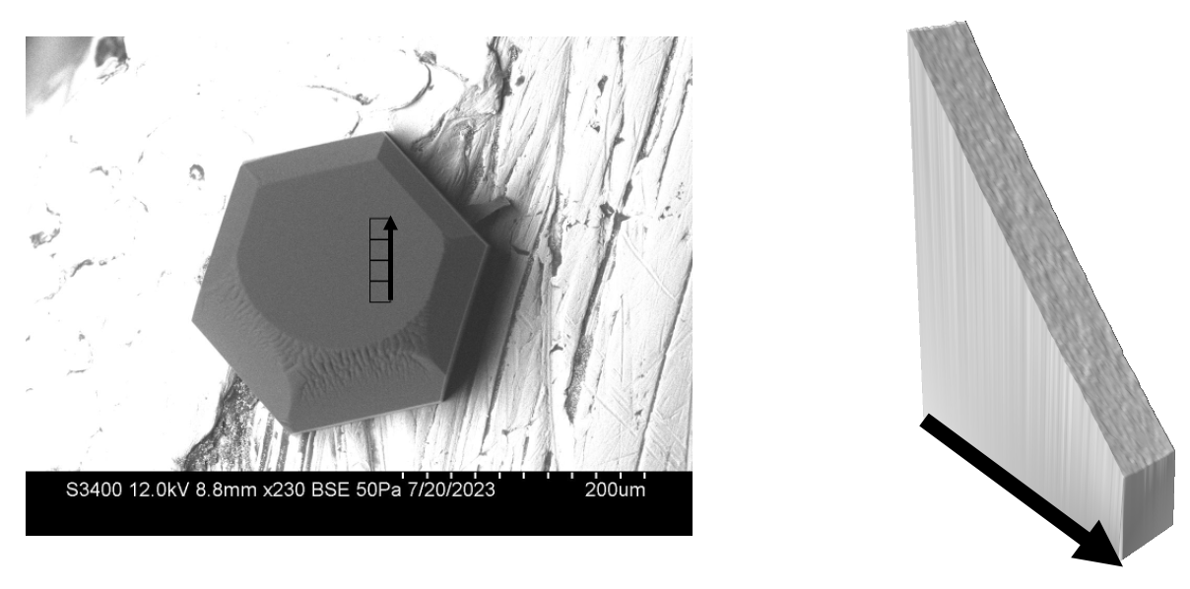
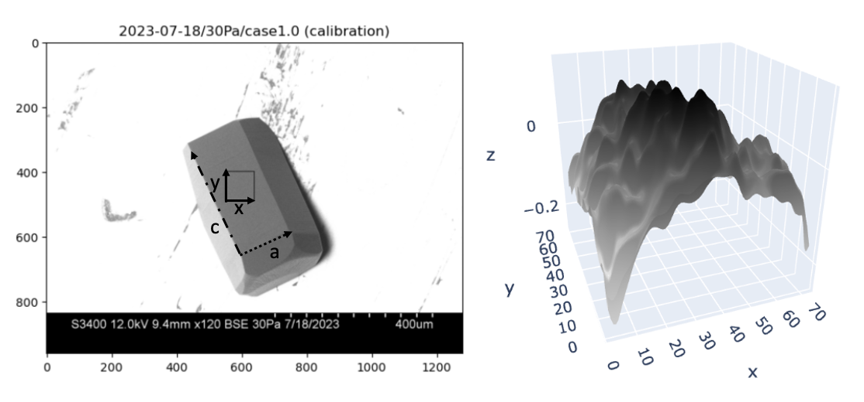
(a)
(b)

